Slide 1

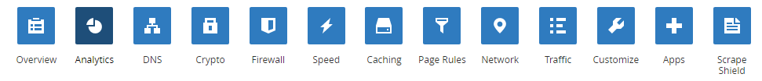


Slide 2
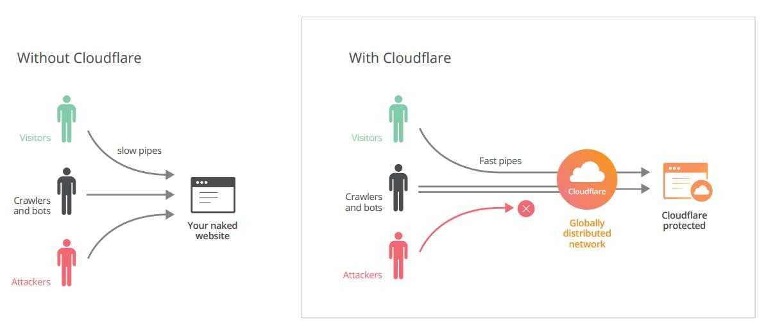
Before and After

Slide 3
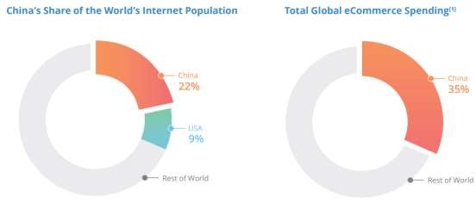
Optimize Web Presence
▶ 750 millions online people in China (1/5 of all internet users)
▶ Complex Infrastructure & Anti malicious attacks
▶ Alibaba , 1 billion in 17 minutes
▶ Amazon increase the revenue 1% for 100 ms
▶ 50% DDoS attacks China

Slide 4
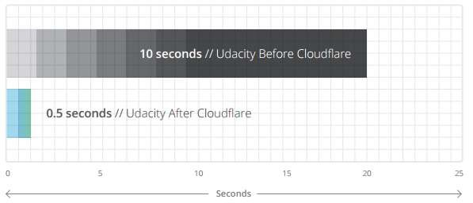
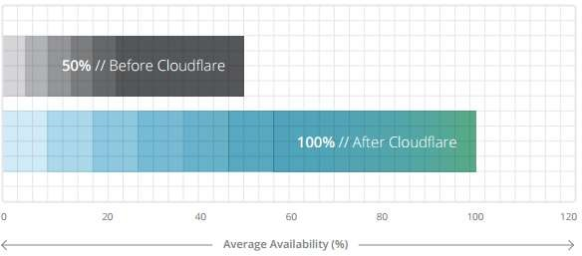
Optimize Web Presence
▶ 25 CloudFlare’s endpoints in China
▶ Udacity Before and After (In China)

Slide 5
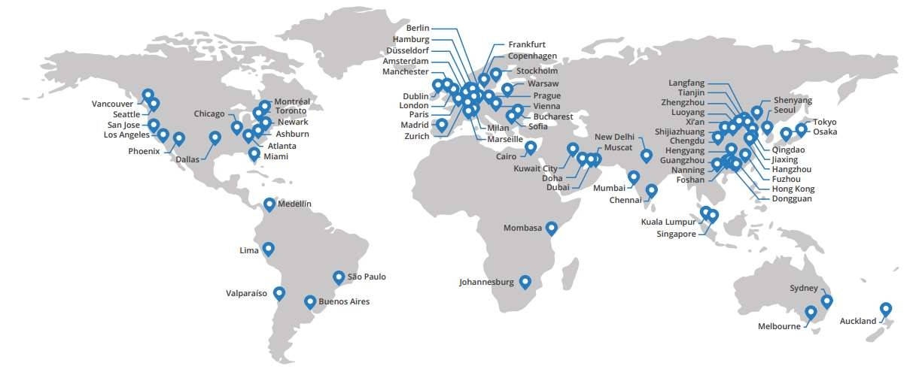
Cloudflare’s network

Slide 6
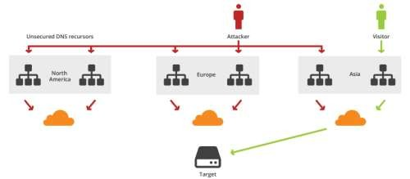
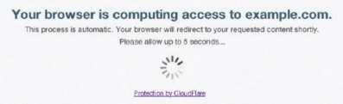
DDoS on Rise
▶ Amazon was down for (15-45 min) in 2013 , lose 5.3 millions
▶ DDoS as Service (starting from 5$)
▶ DoS , DDoS , DRDoS , …
▶ At layer 3 and 4
▶ TCP / UDP / ACK
▶ Flood to consume the resources
▶ At layer 7
▶ look for slow page
▶ Cloudflare protect you from DDoS in layers 3,4 and 7 (up to 400 GB)
▶ Still if you have attack , then you can use I’m under Attack (Additional Protection)
▶ You can customize the block page (Put support email , phone…)

Slide 7
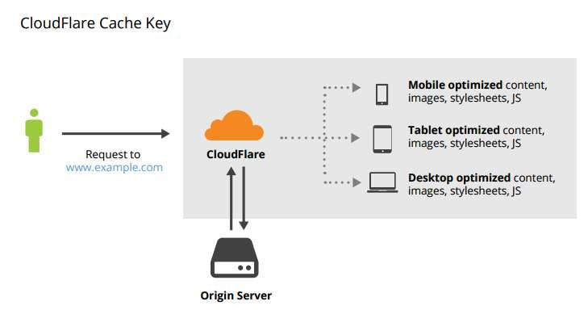
Mobile
▶ 80% of device will be mobile by 2017
▶ 75% of mobile users give up with 4 sec of waiting
▶ Cloudflare can cache based on device
▶ Less API communications

Slide 8
WAF - Another Layer of Defense
▶ Layer 7 (add less than 1 ms latency and no taxs)
▶ Protecting from Common vulnerabilities like XSS and Injections
▶ OWASP Top 10 identified vulnerabilities
▶ Support ModSecuirty Rules
▶ Protect from zero-day vulnerabilities
▶ Reports
▶ PCI Certified

Slide 9
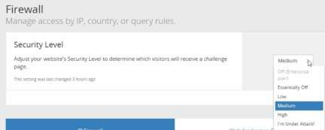
Firewall - Another Layer of Defense
▶ Based on score and behavior
▶ It can be offset by answering a "challenge“
▶ Allow , Block , Challenge , Simulate and Threshold (Rules)
▶ Use Tor browser (Challenge)
▶ You can block IPs
▶ You can’t block the whole country but you can put
challenge
▶ You can increase the level for some pages (like login)
▶ Prevent automation injection not the manual (not full prove)

Slide 10
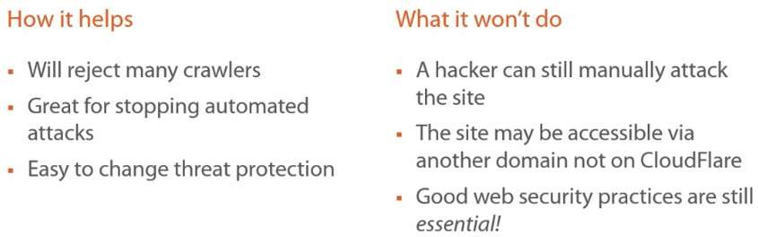
Firewall - Another Layer of Defense

Slide 11
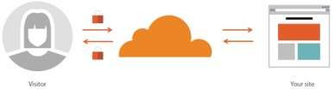
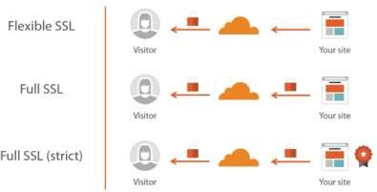
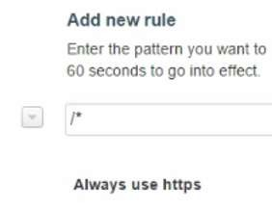
SSL for Free
▶ Take 24 hours (you may need to keep HTTP)
▶ Test it with SSL Labs (Strong and Updated Certificate)
▶ Three options
▶ Use Full or Strict when possible
▶ Rule for redirect from http to https from Page Rules
▶ HSTS

Slide 12
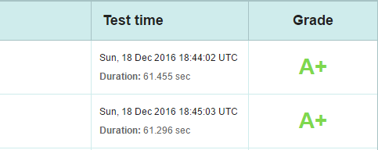
Free Features - Security
▶ Easy to Configure (less than 5 minutes)
▶ 5 trillion web requests per month
▶ Spam protection
▶ Threat protection
▶ Block visitors by IP range
▶ Block visitors by country
▶ Basic DDoS protection
▶ Free SSL
▶ SPDY and Http/2 support
▶ OCSP/CRL check
▶ SSL best practices implementation (support TLS 1.3)

Slide 13
Free Features - Performance
▶ Globally load balanced CDN (endpoints) (Zero configuration)
▶ 10 trillions requests (10% on internet requests)
▶ Ranked fastest CDN (in US , take 34 ms)
▶ Anycast (instead of unicast) like smart routing (closer to user)
▶ Automatic static content caching (66% of contents is cachable)
▶ Cache dynamic contents (study the changes , compress and send the changes only)
▶ Automatic minifying
▶ Always online (100 % SLA for enterprise)
▶ Redundant Servers and DR
▶ Automatic Load balance based on regions

Slide 14
Free Features - Performance
▶ Polish (remove metadata) and Mirage image optimization
▶ Sanitize Headers (for example remove X-Powered-By)
▶ Support IPv6 (10% more faster than IPv4)

Slide 15
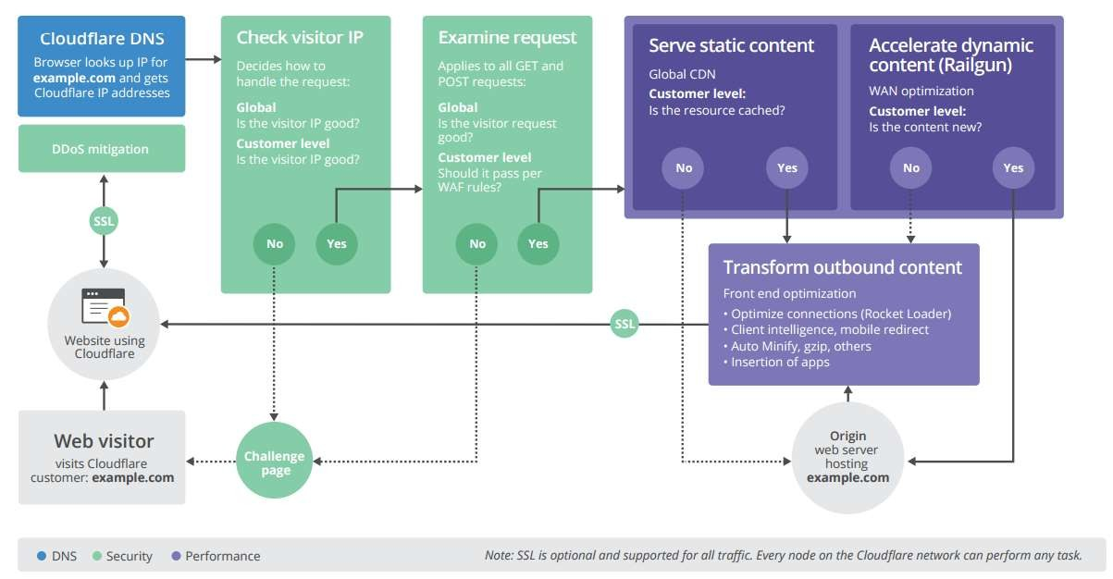
Cloudflare

